Slide 1

Ruby Language

Slide 2
About today…
Object Oriented Programming
Inheritance
Encapsulation

Slide 3
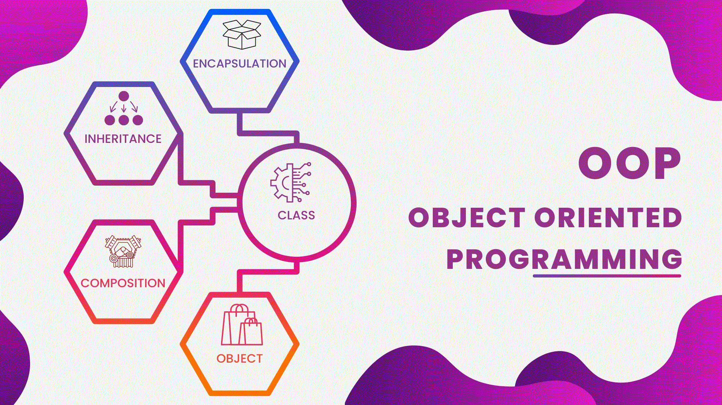

Slide 4

Inheritance in Ruby
Inheritance allows a class to inherit methods and attributes from another class
Promotes code reusability and logical hierarchy

Slide 5
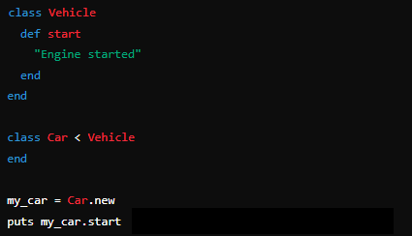
Implementing Inheritance in Ruby
Use the < symbol to create a subclass
Subclass inherits methods from the superclass

Slide 6
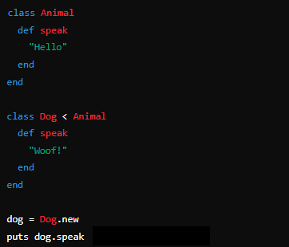
Overriding Methods
Subclasses can override methods from the superclass

Slide 7
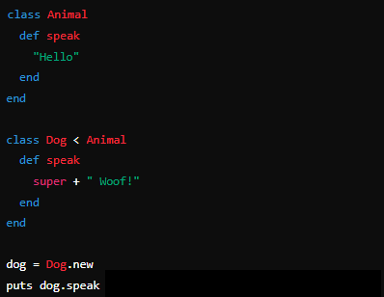
Using ‘super’ keyword
The ‘super’ keyword calls the same method from the superclass

Slide 8
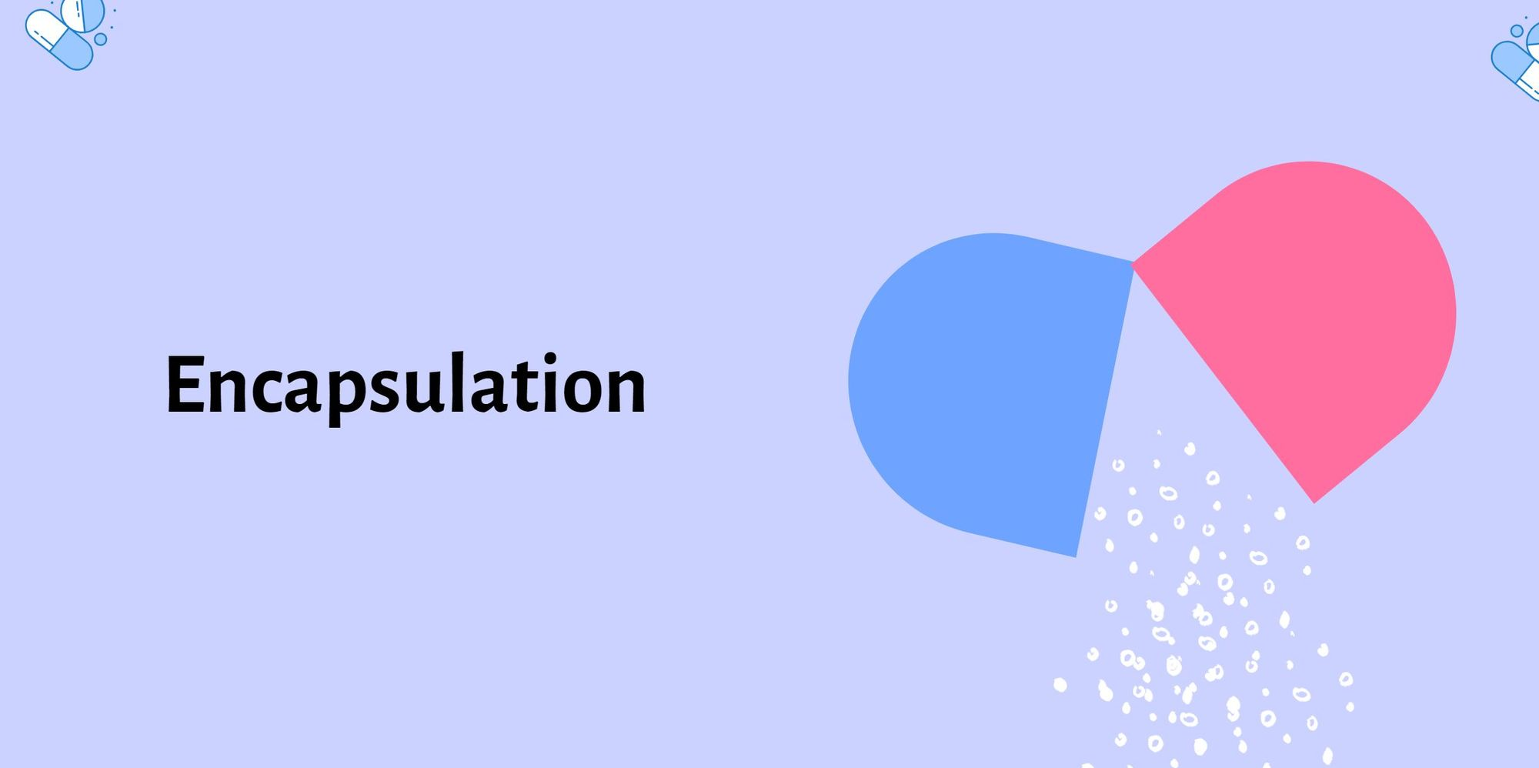

Slide 9
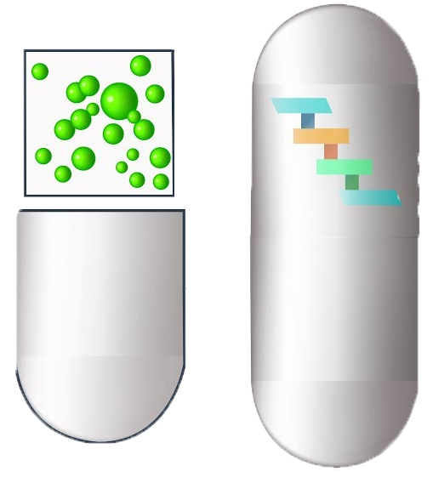
Encapsulation in Ruby
Encapsulation restricts direct access to some of an object's components
Protects object integrity by preventing external interference
Achieved using access control keywords: public, private, and protected

Slide 10
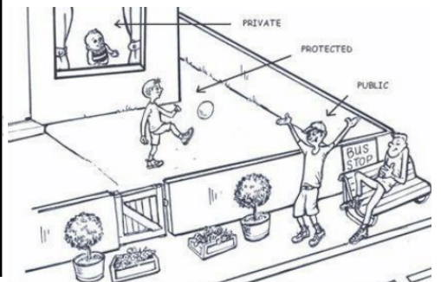
Access Control Keywords
Public
Methods accessible from outside the class
Private
Methods not accessible from outside the class; only within the class
Protected
Methods accessible to instances of the same class or subclasses

Slide 11
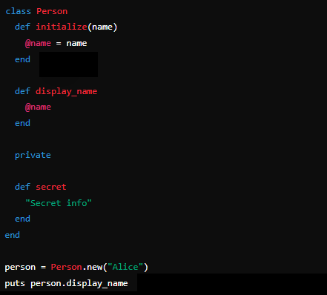
Access Control Keywords : Example

Slide 12
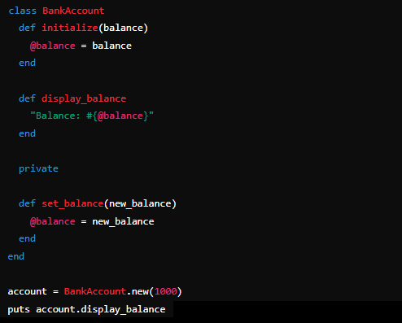
Access Control Keywords : Example

Slide 13


Slide 14

What is inheritance in Ruby?
Which keyword is used to create a subclass in Ruby?
How can you call a method from the superclass in Ruby?
What is encapsulation in Ruby?
Which access modifier makes a method only accessible within the class it is defined in?
How do you define a private method in Ruby?

Slide 15

Task 1
Imagine you are a software developer tasked with creating a transportation system for a company that manages various types of vehicles. The system needs to handle different types of vehicles such as cars, bikes, and trucks. Each type of vehicle shares some common behaviors, but also has its own unique characteristics
Task 2
Imagine you are developing a banking application that needs to securely manage customer bank accounts. The application should restrict direct access to the account balance and only allow changes through specific methods to ensure data integrity.

